Slide 1
Syllables in English
Practice / Reflection activities

Slide 2
Syllable well-formedness in English
Practice / Reflection activities

Slide 3

Syllable Well-formedness
Some of the following one-syllable words are valid in English and others are not.
Decide which ones are not valid. Explain why. (Click on the “comments” boxes for suggested answers.)
No. | word | transcr. | comment
1 | glalt | /glalt/ | ✓ (though must /a/→ /ɑ/ or /ɔ/ before /lt/ in non-loan words?)
2 | inlli | /ɪnɬi/ | ✗ /ɬ/ not a phoneme in English
3 | pnip | /pnɪp/ | ✗ /pn/ not a valid onset
4 | seesh | /siʃ/ | ✓ like <see> and <leesh>
5 | sclinth | /sklɪnθ/ | ✓ like <sclerosis> and < plinth>
6 | scrong | /skɹɒŋ/ | ✓ like <screen> and <long>
7 | trah | /tɹɑh/ | ✗ /h/ can’t occur in coda position!
8 | betr | /bɛtr̥/ | ✗ /r̥/ not a phoneme in English! /tC/ codas only permitted if /ts/, e.g., <acts> /akts/
Created by Antoin Rodgers under Creative Commons Attribution-ShareAlike 4.0 License - rodgeran@tcd.ie - @phonetic_antoin
Notes:
1 glalt [glɑlt] YES? glad - halt (must /a/-->/ɑ/,__/lt/
2 inlli [ɪnɬi] NO /ɬ/ not a phoneme in English
3 pnip [pnɪp] NO [pn] X
4 seesh [siʃ] YES see – leesh
5 sclinth [sklɪnθ] YES sclerosis – plinth
6 scrong [skrɒŋ] YES screen – strong
7 trah [tɹɑh] NO /h/ coda not possible
8 betr [bɛtr] NO [r] not a phoneme in English AND [tr] not a valid coda in varieties with trills
9 hnimny [hnɪmni] NO [hn] X

Slide 4
Syllable Well-formedness
Some of the following one-syllable words are valid in English and others are not.
Decide which ones are not valid. Explain why.
No. | word | transcr. | comment
1 | glalt | /glalt/ | ✓ (though must /a/→ /ɑ/ or /ɔ/ before /lt/ in non-loan words?)
2 | inlli | /ɪnɬi/ | ✗ /ɬ/ not a phoneme in English
3 | pnip | /pnɪp/ | ✗ /pn/ not a valid onset
4 | seesh | /siʃ/ | ✓ like <see> and <leesh>
5 | sclinth | /sklɪnθ/ | ✓ like <sclerosis> and < plinth>
6 | scrong | /skɹɒŋ/ | ✓ like <screen> and <long>
7 | trah | /tɹɑh/ | ✗ /h/ can’t occur in coda position!
8 | betr | /bɛtr̥/ | ✗ /r̥/ not a phoneme in English! /tC/ codas only permitted if /ts/, e.g., <acts> /akts/
Created by Antoin Rodgers under Creative Commons Attribution-ShareAlike 4.0 License - rodgeran@tcd.ie - @phonetic_antoin
Notes:
1 glalt [glɑlt] YES? glad - halt (must /a/-->/ɑ/,__/lt/
2 inlli [ɪnɬi] NO /ɬ/ not a phoneme in English
3 pnip [pnɪp] NO [pn] X
4 seesh [siʃ] YES see – leesh
5 sclinth [sklɪnθ] YES sclerosis – plinth
6 scrong [skrɒŋ] YES screen – strong
7 trah [tɹɑh] NO /h/ coda not possible
8 betr [bɛtr] NO [r] not a phoneme in English AND [tr] not a valid coda in varieties with trills
9 hnimny [hnɪmni] NO [hn] X

Slide 5
Syllable Trees
Practice / Reflection activities

Slide 6
Syllable Trees
Draw syllable trees for the following words:
<sprite> /spɹaɪt/
<acting> /ˈaktɪŋ/
<petty> /ˈpɛti/ (or /ˈpɛɾi/*)
* [ɾ] is actually an allophone of /t/. It occurs intervocalically after a stressed syllable in some varieties of English, notably in General American English. However, it is not uncommon to see it treated as a phoneme in dictionary form citations.
Created by Antoin Rodgers under Creative Commons Attribution-ShareAlike 4.0 License - rodgeran@tcd.ie - @phonetic_antoin
Notes:
1 glalt [glɑlt] YES? glad - halt (must /a/-->/ɑ/,__/lt/
2 inlli [ɪnɬi] NO /ɬ/ not a phoneme in English
3 pnip [pnɪp] NO [pn] X
4 seesh [siʃ] YES see – leesh
5 sclinth [sklɪnθ] YES sclerosis – plinth
6 scrong [skrɒŋ] YES screen – strong
7 trah [tɹɑh] NO /h/ coda not possible
8 betr [bɛtr] NO [r] not a phoneme in English AND [tr] not a valid coda in varieties with trills
9 hnimny [hnɪmni] NO [hn] X

Slide 7
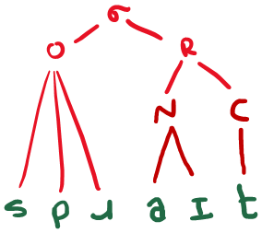
Syllables trees
Draw syllable trees for the following words:
<sprite> /spɹaɪt/
Created by Antoin Rodgers under Creative Commons Attribution-ShareAlike 4.0 License - rodgeran@tcd.ie - @phonetic_antoin
Notes:
1 glalt [glɑlt] YES? glad - halt (must /a/-->/ɑ/,__/lt/
2 inlli [ɪnɬi] NO /ɬ/ not a phoneme in English
3 pnip [pnɪp] NO [pn] X
4 seesh [siʃ] YES see – leesh
5 sclinth [sklɪnθ] YES sclerosis – plinth
6 scrong [skrɒŋ] YES screen – strong
7 trah [tɹɑh] NO /h/ coda not possible
8 betr [bɛtr] NO [r] not a phoneme in English AND [tr] not a valid coda in varieties with trills
9 hnimny [hnɪmni] NO [hn] X

Slide 8
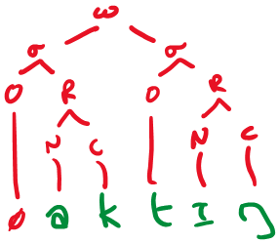
Syllables trees
Draw syllable trees for the following words:
2. <acting> /ˈaktɪŋ/
Created by Antoin Rodgers under Creative Commons Attribution-ShareAlike 4.0 License - rodgeran@tcd.ie - @phonetic_antoin
Notes:
1 glalt [glɑlt] YES? glad - halt (must /a/-->/ɑ/,__/lt/
2 inlli [ɪnɬi] NO /ɬ/ not a phoneme in English
3 pnip [pnɪp] NO [pn] X
4 seesh [siʃ] YES see – leesh
5 sclinth [sklɪnθ] YES sclerosis – plinth
6 scrong [skrɒŋ] YES screen – strong
7 trah [tɹɑh] NO /h/ coda not possible
8 betr [bɛtr] NO [r] not a phoneme in English AND [tr] not a valid coda in varieties with trills
9 hnimny [hnɪmni] NO [hn] X

Slide 9
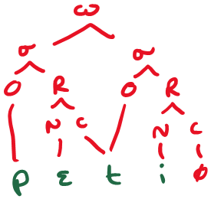
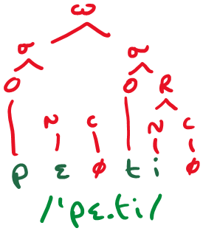
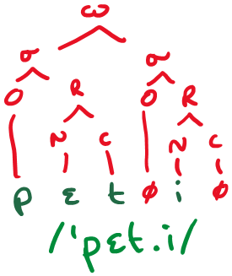
Syllable trees
Draw syllable trees for the following words:
<petty> /ˈpɛti/ (or /ˈpɛɾi/)
Ambisyllabic Approach
(syllables “share” coda and onset)
Prioritize Maximal Onset Principle
Prioritize Rhyme well-formedness rules
Created by Antoin Rodgers under Creative Commons Attribution-ShareAlike 4.0 License - rodgeran@tcd.ie - @phonetic_antoin
Notes:
1 glalt [glɑlt] YES? glad - halt (must /a/-->/ɑ/,__/lt/
2 inlli [ɪnɬi] NO /ɬ/ not a phoneme in English
3 pnip [pnɪp] NO [pn] X
4 seesh [siʃ] YES see – leesh
5 sclinth [sklɪnθ] YES sclerosis – plinth
6 scrong [skrɒŋ] YES screen – strong
7 trah [tɹɑh] NO /h/ coda not possible
8 betr [bɛtr] NO [r] not a phoneme in English AND [tr] not a valid coda in varieties with trills
9 hnimny [hnɪmni] NO [hn] X

